Slide 1
Progress Report 2
Submitted in the partial fulfillment for the award of the degree of
BACHELOR OF ENGINEERING
IN
Computer Science Engineering
Submitted by:
Daksh Rawal-19BCS3849
Aryan Gupta-19BCS3828
Prajwal- 19BCS3831
Under the Supervision of:
Dr.Rahul Rastogi
Department of AIT-CSE
DISCOVER . LEARN . EMPOWER

Slide 2
Outline
Introduction to Project
Assignment of Roles
Problem Formulation
Methodology used
Results and Outputs
Conclusion
Future Scope
References

Slide 3
Introduction to Project
Predicting the future in all the areas using machine learning techniques was the recent research in the current scenario.
Stock market is one among them which needs the prediction future market to invest in the new enterprise or to sell their existing shares to get profit. This need the efficient prediction technique which studies the previous exchanges of stock market and gives the future prediction based on that.

Slide 4
Assignment Of Roles
Research Paper - This part of project is assigned to Daksh Rawal. This includes making of Research Paper in a appropriate format.
Frontend- The frontend part of project is assigned to Aryan Gupta. This includes Development of Web Application to show the output of the project. The technology used is Streamlit, Html, CSS, JS.
Backend- The frontend part of project is assigned to Prajwal. This includes selecting and development of a appropriate machine learning model for the development.

Slide 5
Problem Formulation
Stock Securities trade forecast this is applied to expect destiny estimation of inventory price.
Stock put it on the market expectation facilitates for each consumer and provider of inventory.
The powerful forecast of a inventory’s destiny fee should go back noteworthy gain for each consumer and seller.
This might advocate that each one freely recognized statistic approximately an organization.
To foresee the Share Value of the precise organization we want get the chronicle

Slide 6
Softwares Used
We are using Anaconda Navigator , Jupyter Notebook .
The libraries we are using are :
numpy==1.17.0
plotly==3.10.0
pandas==0.25.0
chart_studio==1.0.0
fbprophet==0.5
Streamlit for frontend website.

Slide 7
Methodology used
The training of model will be done in python and chart_studio, fbprophet will be used.
Fast Api will be used for backend , to host the model .
After successfully hosting the model . We will create frontend website using Streamlit.

Slide 8
Prophet
Prophet is a forecasting procedure implemented in R and Python. It is fast and provides completely automated forecasts that can be tuned by hand by data scientists and analysts.
It is a procedure for forecasting time series data based on an additive model where non-linear trends are fit with yearly, weekly, and daily seasonality, plus holiday effects. It works best with time series that have strong seasonal effects and several seasons of historical data. Prophet is robust to missing data and shifts in the trend, and typically handles outliers well.

Slide 9
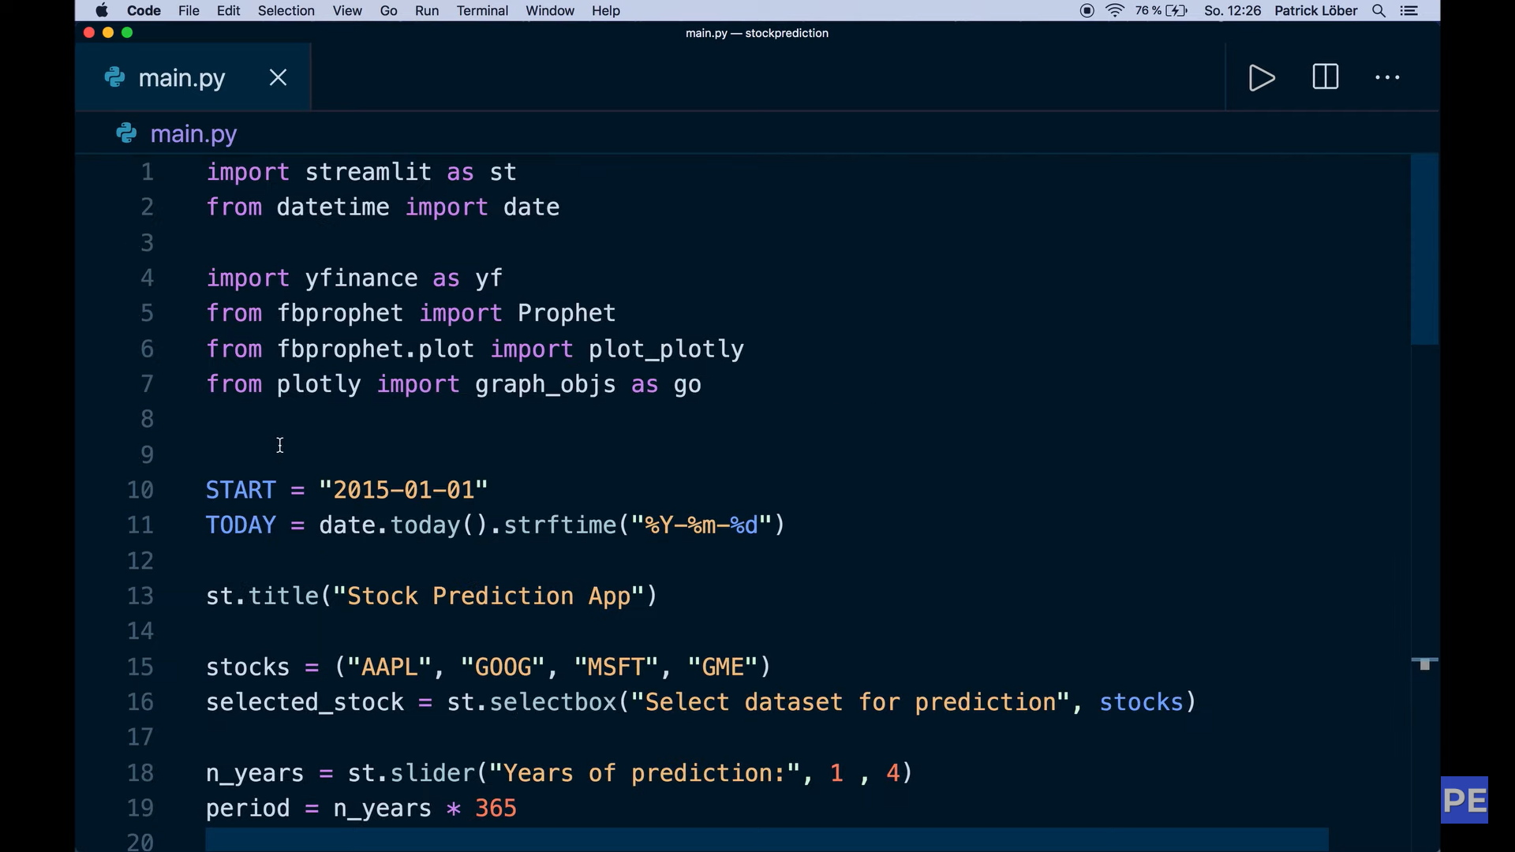
Training of the Model

Slide 10
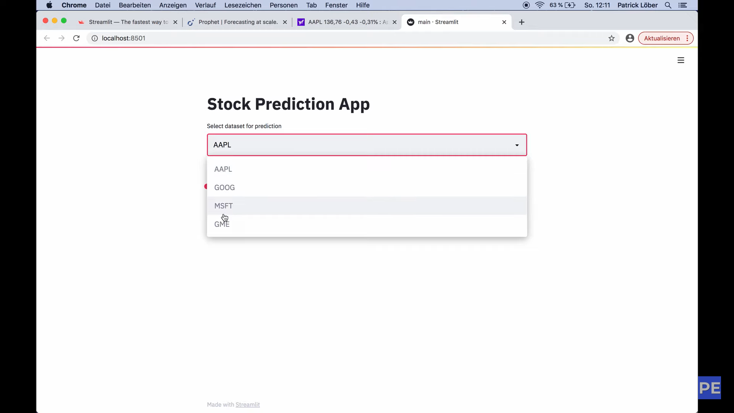
Results

Slide 11
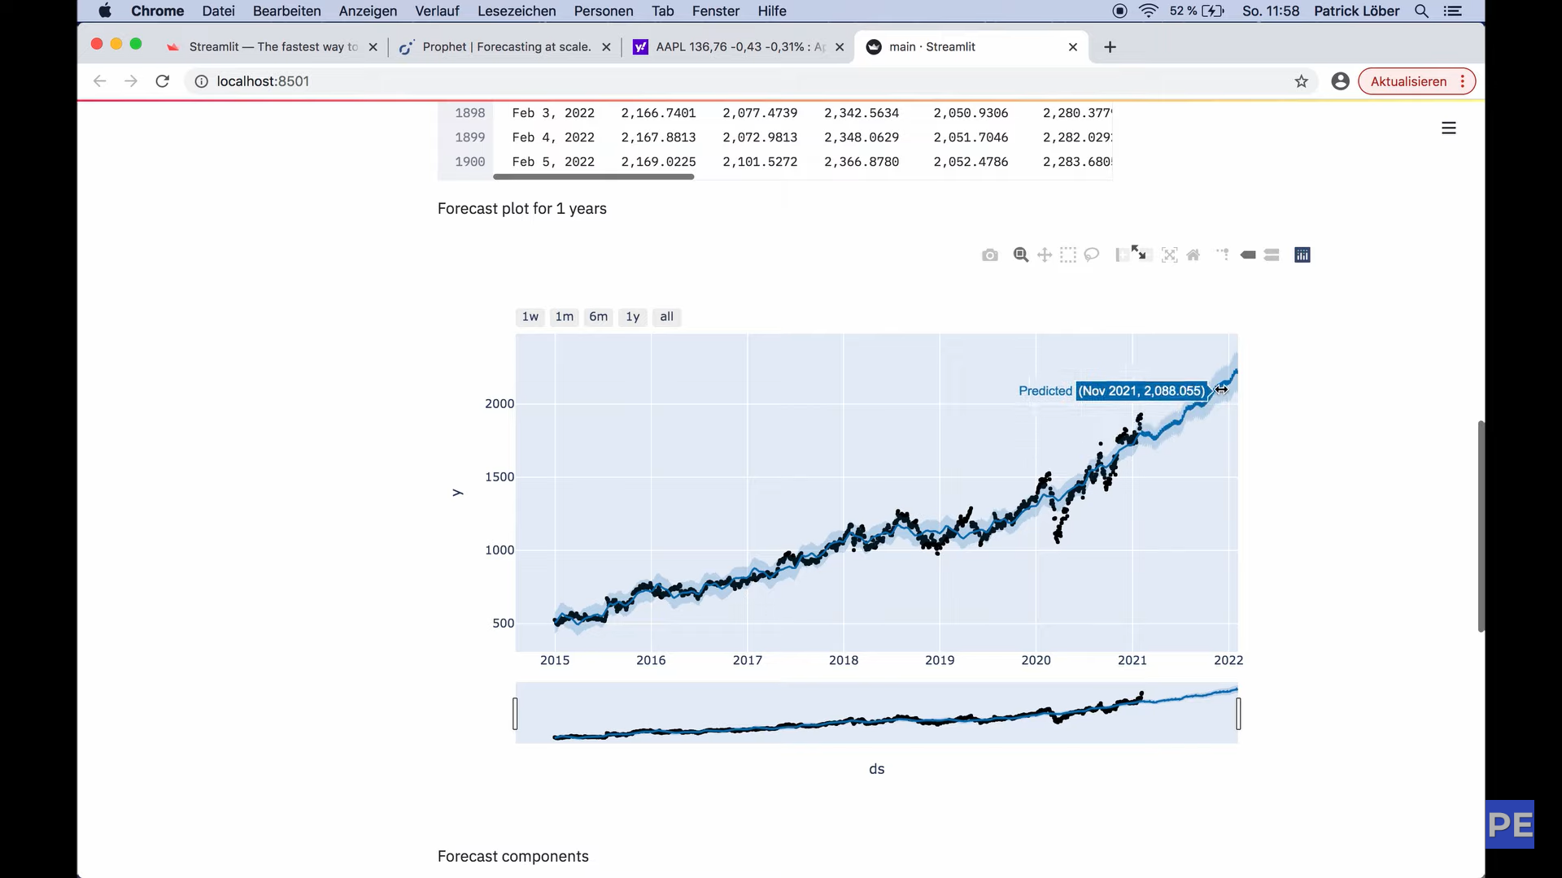

Slide 12
Conclusion
We were able to achieve the goals that we set for our project till now.
The model has achieved great accuracy. Backend and Frontend is working efficiently.
The model is working efficiently and website is able to fetch results .

Slide 13
Future Scope
The future advancements that can are possible regarding this project is building a phone application.
Also this project is hosted on our local server and we can host it on google cloud so that model can be used remotely.

Slide 14
References
Hu Z, Zhu J, Tse K. Stocks market prediction using support vector machine. In 2013 6th International Conference on Information Management, Innovation Management and Industrial Engineering 2013 Nov 23 (Vol. 2, pp. 115-118). IEEE.
Usmani M, Adil SH, Raza K, Ali SS. Stock market prediction using machine learning techniques. In 2016 3rd international conference on computer and information sciences (ICCOINS) 2016 Aug 15 (pp. 322-327). IEEE.
Mankar T, Hotchandani T, Madhwani M, Chidrawar A, Lifna CS. Stock market prediction based on social sentiments using machine learning. In 2018 International Conference on Smart City and Emerging Technology (ICSCET) 2018 Jan 5 (pp. 1-3). IEEE. Reshma R et al. / Stock Market Prediction Using Machine Learning Techniques 339
Ouahilal M, El Mohajir M, Chahhou M, El Mohajir BE. Optimizing stock market price prediction using a hybrid approach based on HP filter and support vector regression. In 2016 4th IEEE International Colloquium on Information Science and Technology (CiSt) 2016 Oct 24 (pp. 290-294). IEEE.
Huang H, Zhang W, Deng G, Chen J. Predicting stock trend using fourier transform and support vector regression. In 2014 IEEE 17th International Conference on Computational Science and Engineering 2014 Dec 19 (pp. 213-216). IEEE

